Slide 1
Ethereum & Solidity
Hackathon 2018

Slide 2
Table of Contents
3 – Ethereum
4 – Solidity
5 – Function Types
6 – Variable Types
7 – Example Contract
8 – Remix
9 – Assignment

Slide 3
Ethereum
A world-wide network of computers running the Ethereum Virtual Machine (EVM)
Runs smart contracts – essentially just pieces of code
Ether is the native currency
Transactions cost gas – it costs money to call functions

Slide 4
Solidity
Similar to JavaScript
Statically typed language
.sol file extension
Use Remix – in browser IDE

Slide 5
Function types
function name() types
public – anyone can call it
private – can only be called within the contract
view – returns data, does not modify any data
payable – send Ether when calling
returns (varType)
Many more built in functions!
Cannot return data from functions that modify data

Slide 6
Variable types
address – holds an Ethereum address
array
bool
fixed/ufixed – not fully supported by Solidity (yet)
int/uint – uint can only be positive
mapping
string

Slide 7
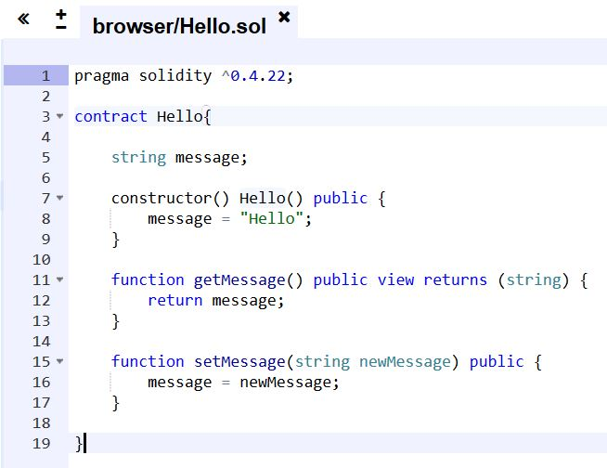
Example contract
Class
Constructor
Getter
Setter

Slide 8
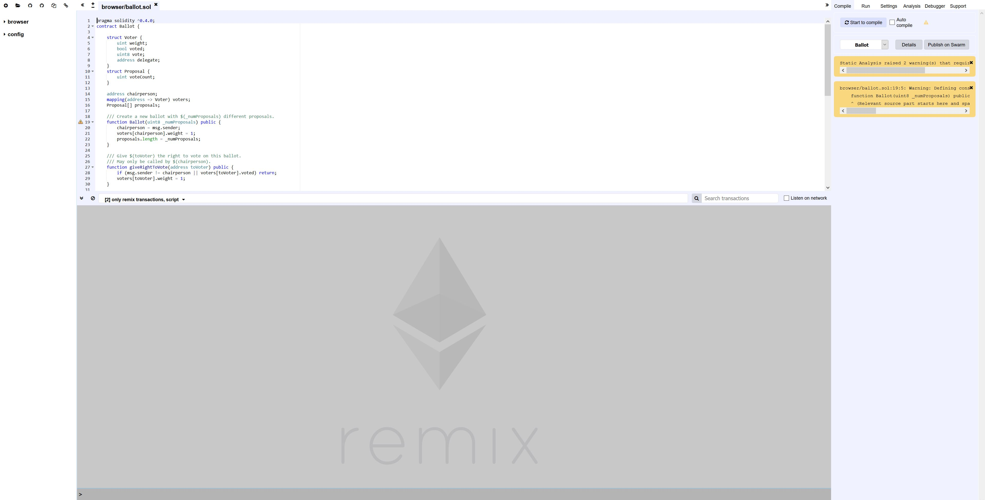
https://remix.ethereum.org

Slide 9
Assignment
Make a lottery smart contract
https://goo.gl/E1GJaN
Ask questions
Have fun!

Slide 10
Summary
Ethereum is a worldwide network of computers
Users must pay for computation
Solidity is the native language

